Slide 1
British Airways Virtual Internship
Web scrapping and sentiment analysis of customer reviews

Slide 2
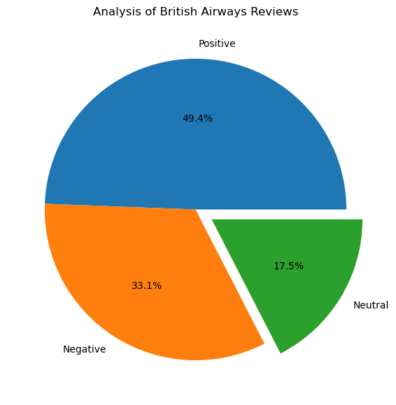
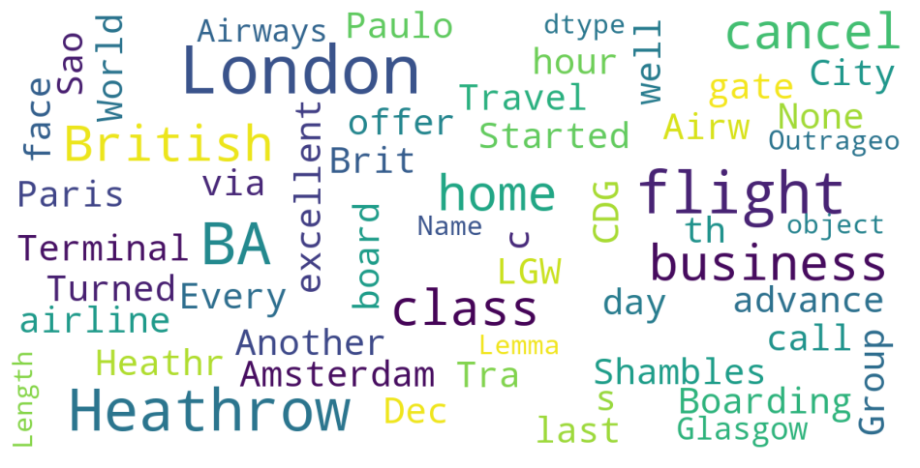
Web scrapping 2000 customer reviews of British Airways from https://airlinequality.com using the BeautifulSoup package. Performing Sentiment analysis for reviews by carrying steps such as 1) Cleaning the text, 2) Tokenization, 3) POS enabling 4) Removal of Stopwords, 5)Obtaining stem words Lexicon-Based approach VADER is used to perform sentiment analysis Total Reviews: 2000, Positive: 988, Negative: 663, Neutral: 349.

